Slide 1
Induction
Mirko Farina
Assistant Professor
m.farina@innopolis.ru
* I do not claim authorship for all texts and pictures in the presentation.

Slide 2
…… Summary
Deductive Reasoning
Categorical Logic
Propositional Logic
Predicate Logic
Today, we enter the last block of our course, which will be about with Inductive Reasoning

Slide 3
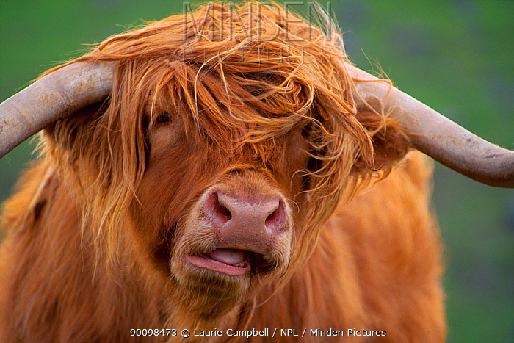
Consider this argument:
P1) Triona lives in Inverness.
---------
C) Triona owns at least one item of woollen clothing.
Is this argument valid?
3

Slide 4
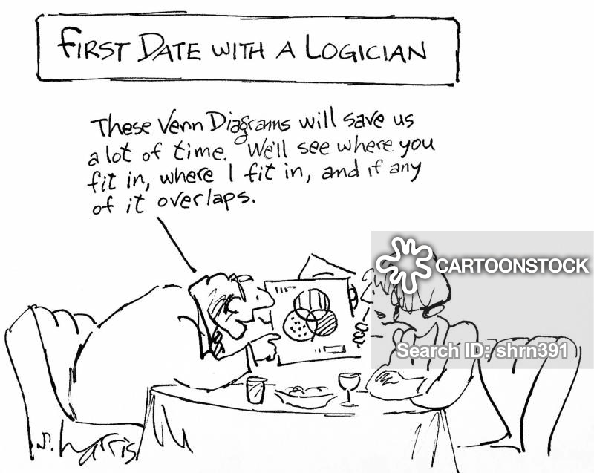
It would not make much sense for a logician, a kind of person who only uses deductive reasoning and does not know anything about Inverness…
4

Slide 5


Given what we know about Inverness, we can expect than almost everyone owns wollen garments
We can represent the argument, then, as follows:
P1) Triona lives in Inverness.
P2) Almost everyone in Inverness owns at least one item of woollen clothing.
------------------------- therefore
C) (Probably) Triona owns at least one woollen item of clothing.
5

Slide 6

inductively forceful argument = the truth of the premises does not assure truth of the conclusion!
At best good reasons to believe it
6

Slide 7
We focus on three types of probability : proportion, frequency, and rational expectation.
7

Slide 8

Proportion.
e.g. ‘7/8 of Xs are Ys’.
Probability of drawing an ace:
1/13 = (about 0.077)
8

Slide 9

Frequency.
Snow in London in December?
You find that, out of the past one hundred Decembers, it has snowed during fourteen of them. 14/100 (0.14).
9

Slide 10
Proportion and Frequency are important but sometimes we need something more
10

Slide 11
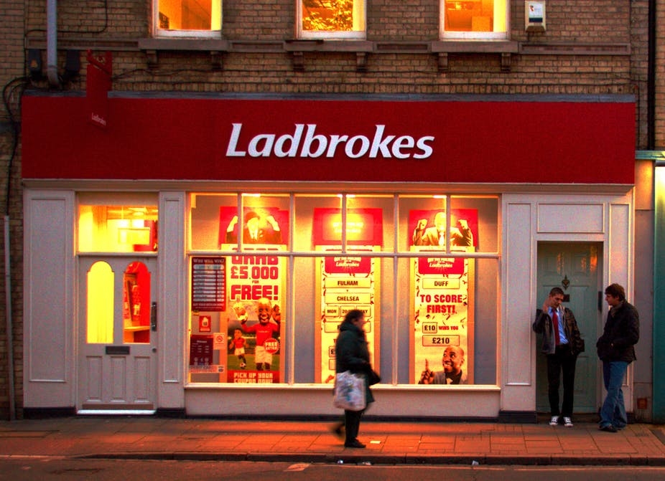
Bookmakers: Mr X becoming the next leader of the Labour Party are 1:1 (i.e. the probability is 1/2).
Frequency is 0
Proportion is also 0
11

Slide 12

How are these prediction made?
Based on the degree of rational expectation
12

Slide 13
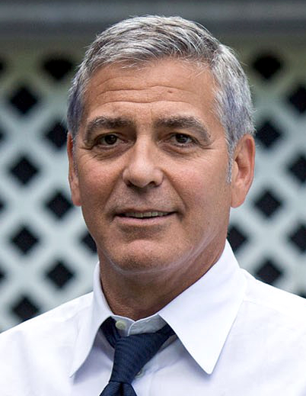
George play cards. Card face down in front of him on the table. He knows it is a red card (managed to see it)
George knows is not a club, his degree of rational expectation that the card is a club is 0).
If he knows that red cards can be either hearts or diamonds then his degree of rational expectation that the card is a diamond is 1/2.
13

Slide 14
degrees of rational expectation = conditional probability.
Degree to which it would be reasonable to accept a certain proposition, given no other relevant information except that contained within a certain set of propositions.
14

Slide 15
Now we can refine our understanding of inductive arguments
Let [Q] stand for one or more premises, and let C stand for a conclusion.
Suppose we have an argument:
[Q] . . .[Q1]…[Q2]
C) C
To say that such an argument is inductively forceful is to say that the conditional probability of C relative to the set [Q] is greater than one-half, but less than 1.
15

Slide 16
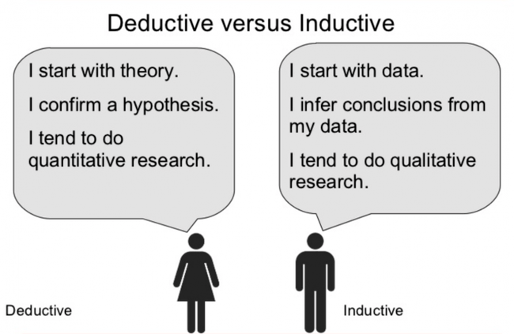
In other words
IF premises are true (or were true), then, it is reasonable to expect the conclusion to be also true
16

Slide 17
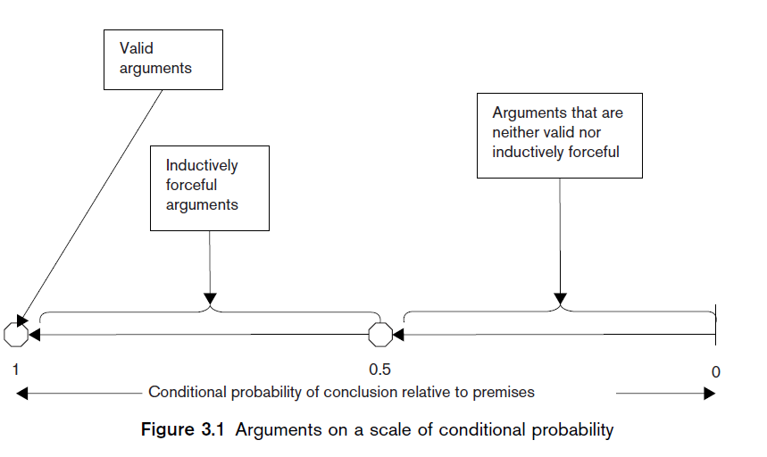
18

Slide 18

A few things to keep in mind:
Probability is not precise enough to justify the attribution of a precise number to it.
Probability is a matter of degree
Because probability has this characteristic, Sometimes the most we can do is to rank probabilities; sometimes we cannot even rank them with confidence.
17

Slide 19
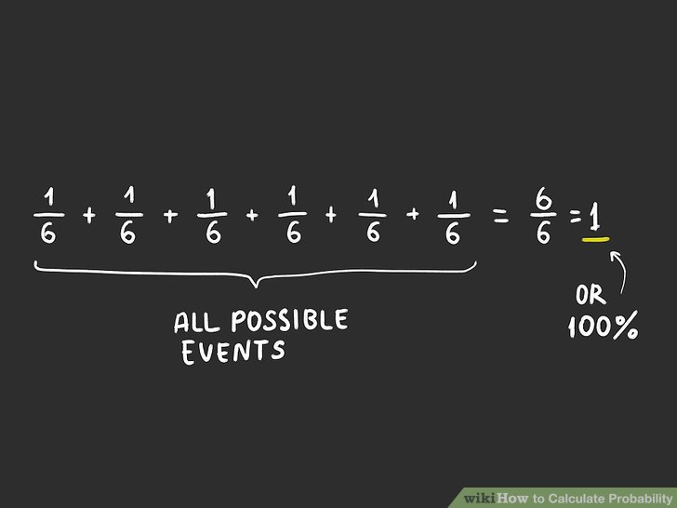
Whether or not an argument is deductively valid does not depend on whether anyone thinks it is.
Likewise probability is based on rational or better reasonable expectations (not subjective ones)
19

Slide 20

Suppose that Aigerim is asked to pick a card. Her probability of picking a diamond is exactly one in four.
Her chance of not getting a diamond is ¾
Probably she won t pick a diamond
Aigerim might not be fully rational (she is in love) and might think ‘I’ll probably choose a diamond’.
The probability that she will not choose a diamond is still greater then the probability that she will.
Her subjective thinking does not influence probability
20

Slide 21
IMPORTANT: the degree of inductive force of an argument is independent of the truth-values of the premises.
Consider:
P1) Almost all Shangs play chess.
P2) Kiros is a Shangs.
---------
(Probably) Kiros plays chess.
21

Slide 22
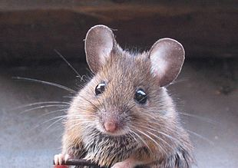
Quantifiers ‘All’, ‘most’ and ‘some’
All rodents have tails - clear
Most rodents have tails - clear
But what about ‘Some rodents have tails’?
What proportion of rodents must have tails for that to be true?
22

Slide 23
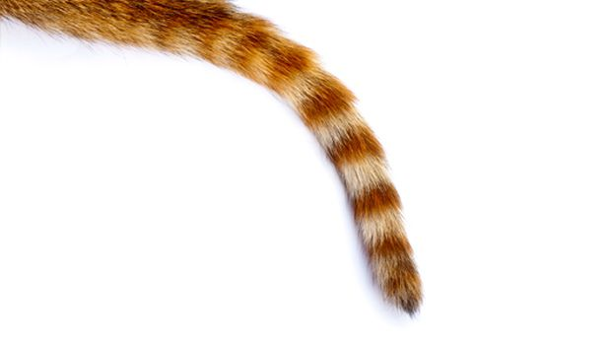
when using ‘some’ in our argument-reconstructions, we must mean ‘at least one’.
‘Some rodents have tails’ means simply that it is not the case that no rodents have tails.
Nothing more…
23

Slide 24
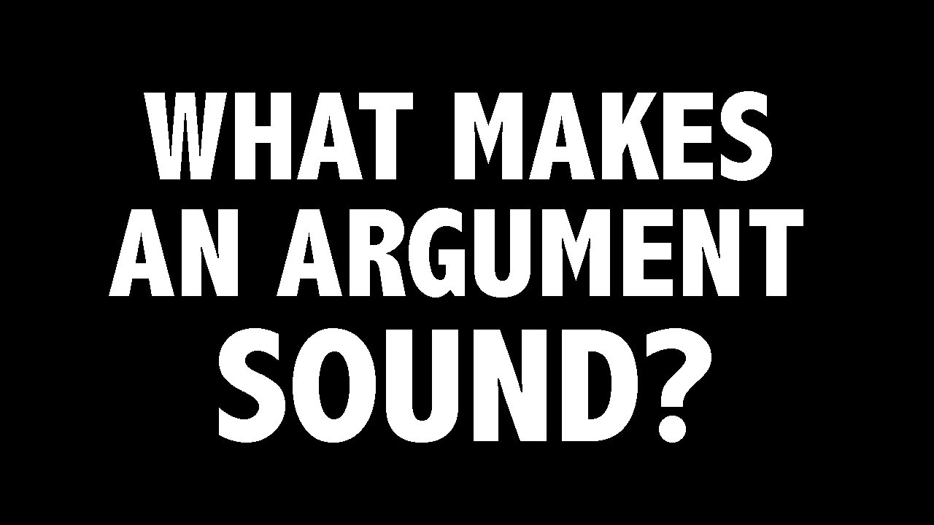
Inductive soundness (or cogency)
To say that an argument is inductively sound (cogent) is to say that it is inductively forceful and its premises are (actually) true.
24

Slide 25
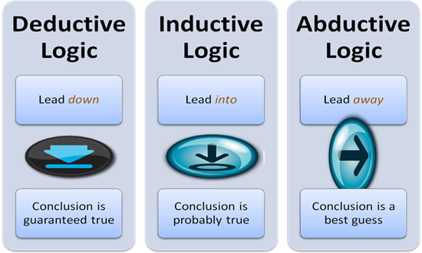
Inductive force in extended arguments
Like in deductive argument, the conclusion of an inductively forceful argument may serve as a premise for a further argument, which may itself be deductively valid, inductively forceful, or neither.
However, if any sub-argument of an extended argument is not deductively valid, then the argument as a whole is not deductively valid.
25

Slide 26
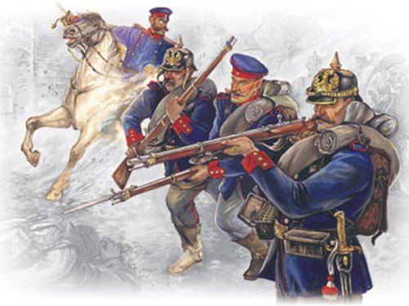
At most, it is inductively forceful. Here is a
hybrid extended argument which illustrates the point:
P1) If Napoleon is not ill then the French will attack.
P2) Probably, Napoleon is not ill.
intermediate C) (Probably) The French will attack.
P4) If the French attack, then the Prussians will be routed.
--------------
C) (Probably) The Prussians will be routed
26

Slide 27
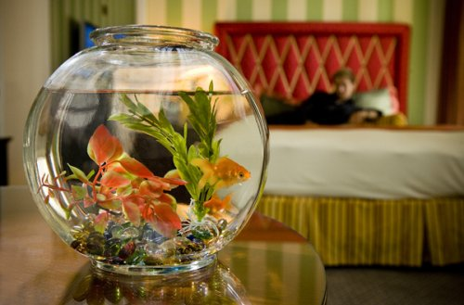
Inductive inferences
Consider the following argument:
So far, every guppy I’ve had has died when I fed it cat food. Therefore, if I feed my new guppy cat food, it will die.
This inference seems reasonable, but how do we reconstruct the argument?
We might try:
P1 (a) All guppies die if fed cat food.
C) My new guppy will die if I feed it cat food.
Or:
P1 (b) Most guppies die if fed cat food.
C) (Probably) My new guppy will die if I feed it cat food.
27

Slide 28

Logical Problem:
Somehow, the arguer must get from the proposition ‘Every guppy I’ve had has died when I fed it cat food’ to ‘Most (or all) guppies die when fed cat food’.
28

Slide 29
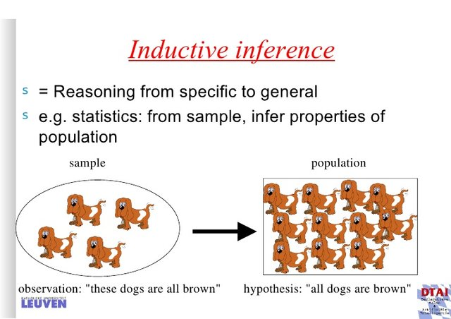
We call it an inductive inference.
[Restricted Sample + Unrepresentative Sample]
UNWARRANTED INFERENCE, OF COURSE BUT VERY COMMON IN LIFE AND IN SCIENCE!
29

Slide 30
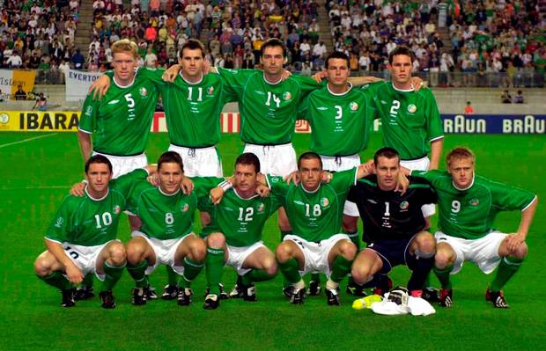
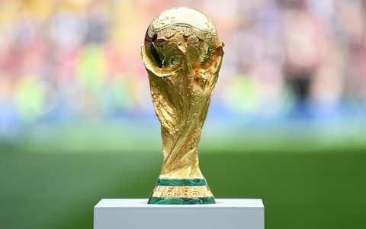
Inductive inferences frequently extrapolate from past to future.
For example, Ireland never won football World Cup and it never will….
However, such inferences are dangerous when applied to society…
30

Slide 31

….?

Slide 32
What did you learn?
- What is Inductive Reasoning
- What is Inductive Forcefulness
- Probability, Frequency, and Rational Expectation
- What is Inductive Soundness
- Differences between Deductive and Inductive Reasoning
- What are Inductive Inferences and why they are dangerous

